Slide 1


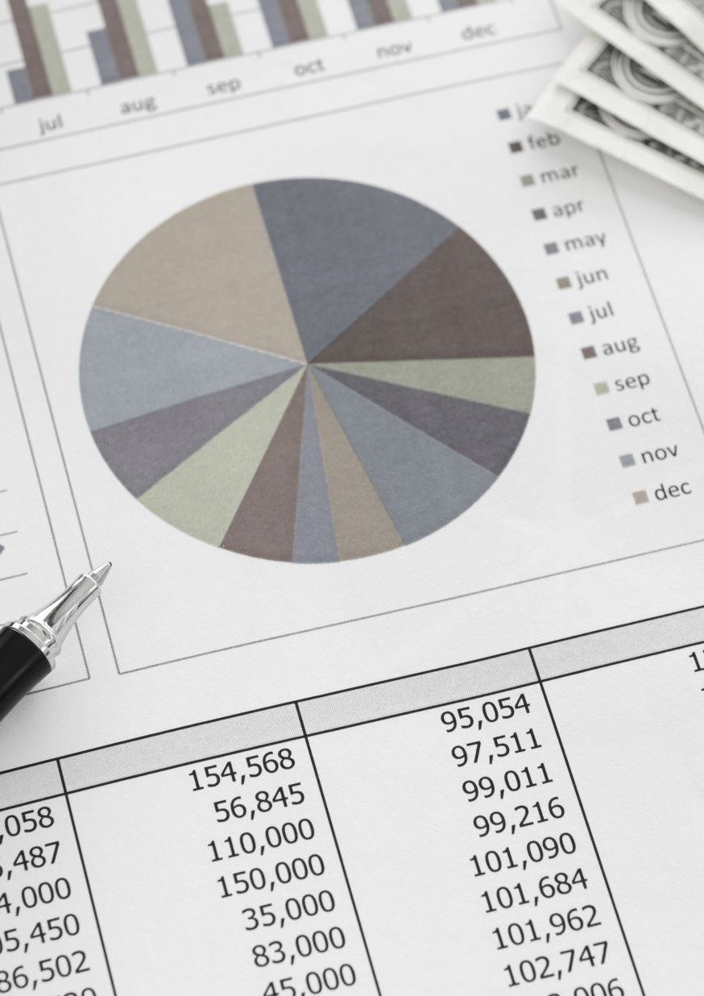

AtliQ Mart Sales And Promotion Analysis
Presented By
Tamanna Jethwani
Notes:
Hello Everyone. I am Tamanna Jethwani and today I am going to explain about the Project Challenge given my Codebasics Team. This project is about AtliQ mart Sales and Promotion Analysis that was conducted during the festival seasons

Slide 2

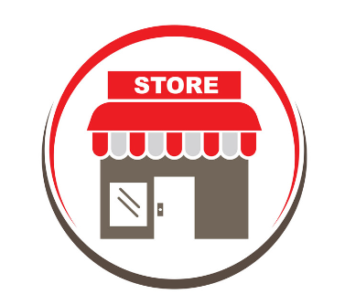

Problem Statement
AtliQ Mart is a retail giant with over 50 supermarkets that ran a massive promotion during Diwali 2023 and Sankranti 2024 on AtliQ branded products.
The Sales director need tangible insights from the Diwali and Sankranti promotions.
He also wants to understand which promotions did well and which did not so
they can make data driven decisions for future promotion events.
Notes:
Atliq Mart is a retail giant with over 50 stores across southern part of India that ran a massive promotion during the festive season of Diwali and Sankranti. After the promotions the sales director wants the insights and want to understand which promotions did well and which did not so that they can make informed decisions for future events.

Slide 3
Data Walkthrough
Data Model consists of 4 Tables
Dim_products – This table consists all the information about the products. Product Id, product name, category of the product are the attributes of the products.
Dim_stores – This table gives us information about the stores that AtliQ Mart has across different cities in southern part of India.
Dim_campaigns – This table gives us an idea of promotional campaign being run by AtliQ Mart.
Fact_events – It gives us the detail information about all the unique activities that occurred during the promotions. Each record gives the information about product id, store id, base price, promotion type applied to the product, quantity sold (before and after promo)
Notes:
Data Model consist of 4 tables

Slide 4
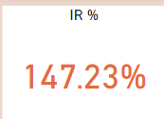
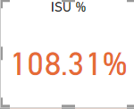
Understanding KPI
There are few Key Performance Indicators that are important pointers in the entire analysis
Incremental Revenue (IR %) – Incremental revenue helps us to understand the impact of promotion on revenue figures.
Formula - IR % = ([Total revenue after promo]-[Total revenue before promo])/[Total revenue before promo]
IR % of 147.23 means the revenue has increased 147.23 % more compared to revenue before promotions.
2) Incremental Sold Units (ISU %) – It defines the percentage increase of number of units sold of all the products across the stores.
Formula - ISU % = ([Total Qty Sold After Promo]-[Total Qty Sold Before Promo])/[Total Qty Sold Before Promo]
ISU % of 108.31 means the percentage increase in quantity sold after pro promotions.

Slide 5
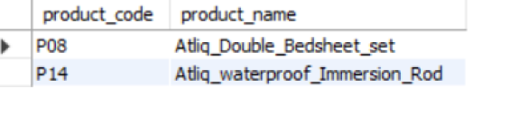
Ad-Hoc-Business-Requests
Business Request 1
Out of all the products sold in AtliQ Mart , the above 2 products are high valued product above 500 and are heavily discounted under Buy One Get One Free promo type
Notes:
List the products that were sold above base price of $500 under promo type BOGOF

Slide 6
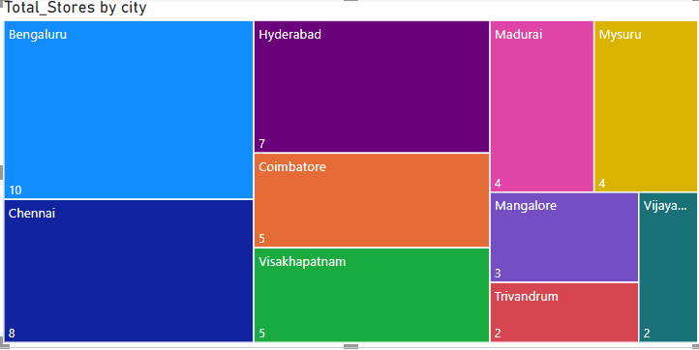
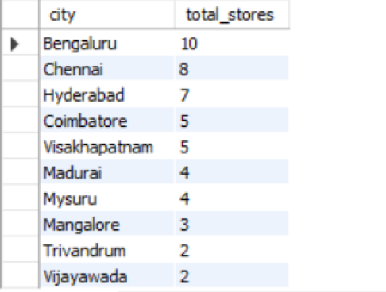
Ad-Hoc-Business-Requests
Business Request 2
These are the total number of stores held by cities. Bengaluru is leading among all.
Notes:
Give an overview of the number of stores held in each city. This allow us to know the highest number of stores presence in each city.

Slide 7
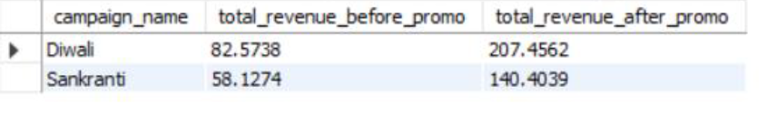
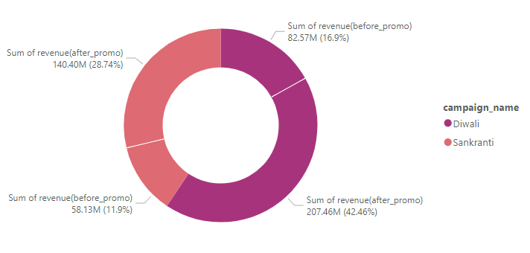
Ad-Hoc-Business-Requests
Business Request 3
Campaign name and their revenue generated before promotions and after promotions
Notes:
The total % increase of revenue for Diwali campaign was 42.46 % and for Sankranti was 28.74 %

Slide 8
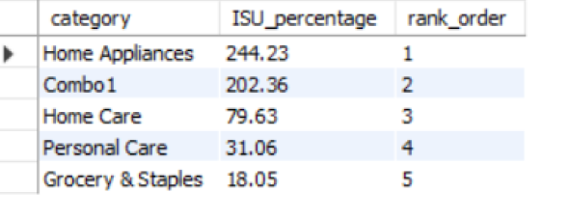
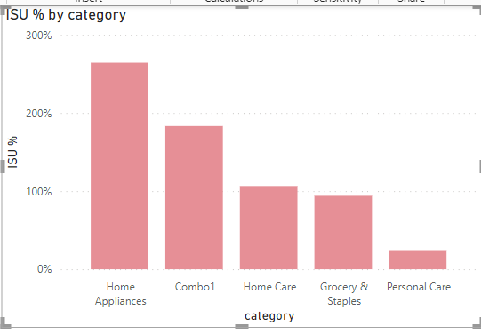
Ad-Hoc-Business-Requests
Business Request 4
The table explains the category wise quantity sold. Many preferred to buy products from category home appliances during the promotional event.
ISU indicates the percentage of quantity sold before and after promotion.
Notes:
This business request help us to understand category wise % increase in the quantity sold after promotions. We can see that people bought more products from home appliance category

Slide 9
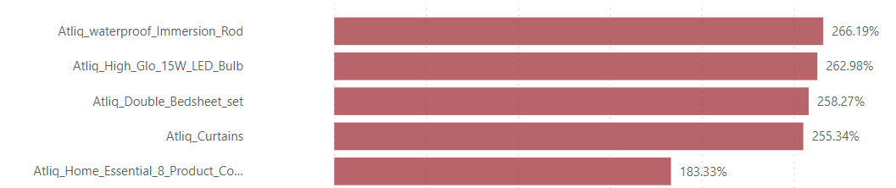
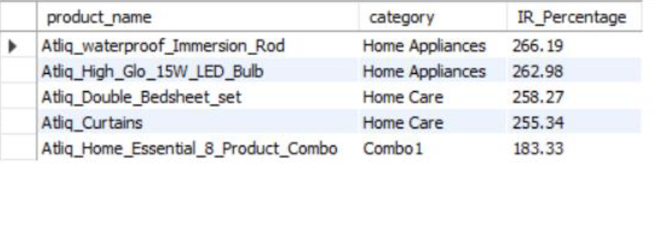
Ad-Hoc-Business-Requests
Business Request 5
The table gives the list of top 5 selling products that generated maximum revenue.
IR indicates the percentage increase of revenue before and after promotion.
Notes:
Top 5 selling products during the promotional event along with the incremental revenue generated from top selling products.

Slide 10
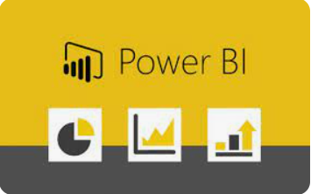
AtliQ Mart Sales And Promotion Analysis Using Power BI

Slide 11
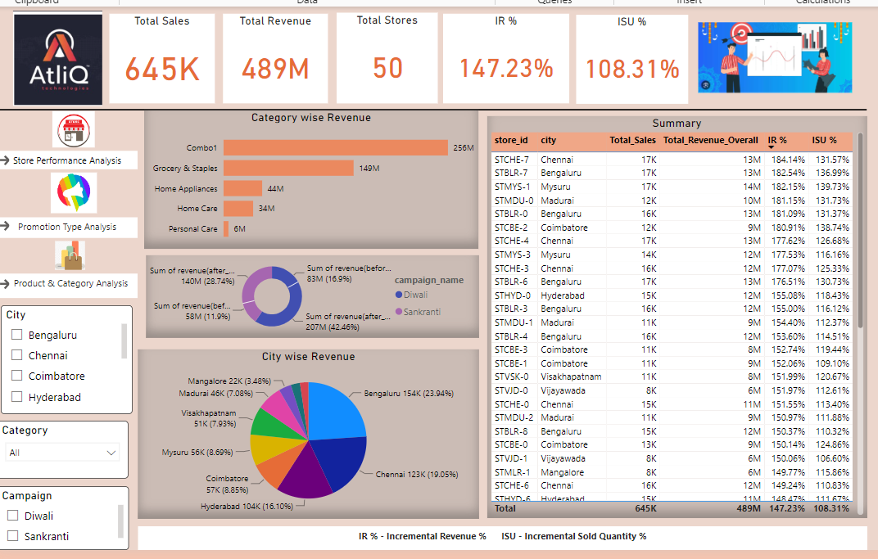
Dashboard View
The Dashboard view gives us the summary of revenue per category, city and campaign. The deeper insights are present under Store Performance Analysis, Promotion Type Analysis and Product and Category Analysis
Notes:
The dashboard overview gives us the overall summary and the detail analysis are captured under the store performance analysis, promotion type analysis and product/category analysis

Slide 12
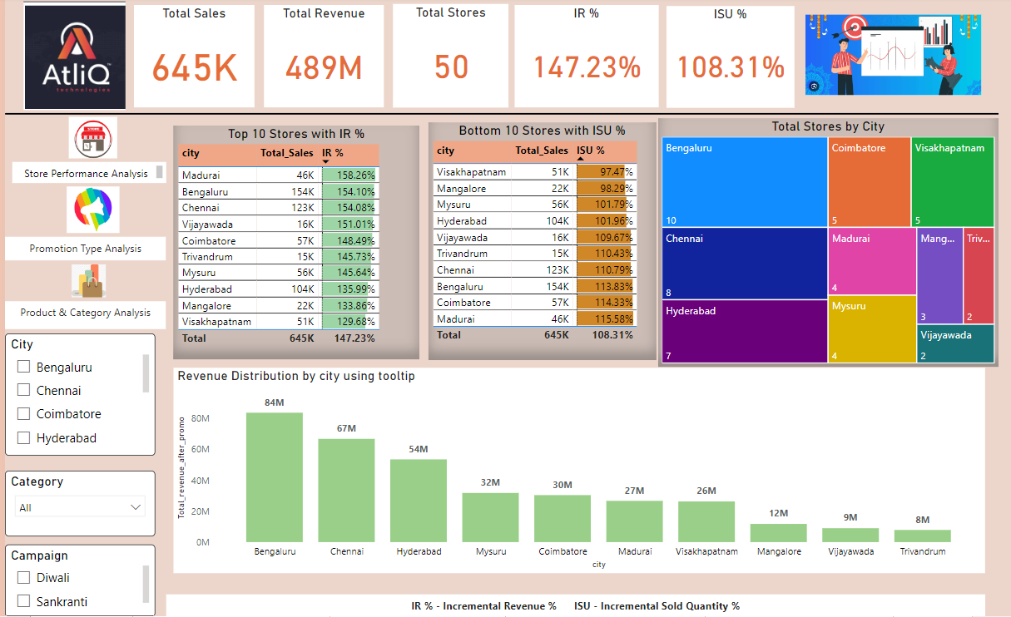
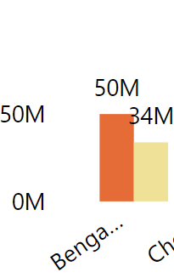
Store Performance Analysis
This view gives us detail insights of stores in terms of quantity sold, revenue generation.
Notes:
This page gives us an idea about the stores that performed well in which city . I have used tooltip to show campaign wise revenue distribution of each city.
Madurai generated maximum revenue even though the quantity of sold units were very less as compared to other cities.

Slide 13
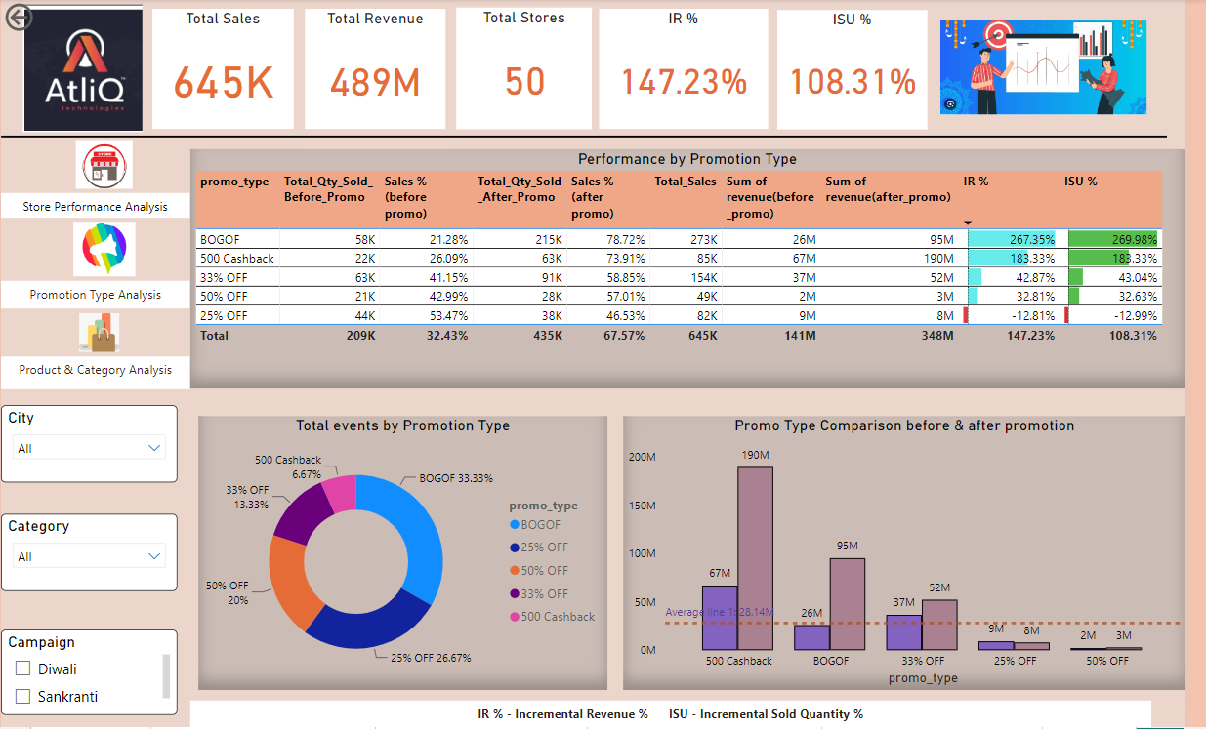
Promotion Type Analysis
The analysis tells us about the performance based on the promotion type applied to the products.
Notes:
BOGOF promotion type was the huge success followed by 500 cashback. The other discount promo types performed below the average line. So these promo type did not generated revenue instead gave losses as seen in IR % and ISU %.

Slide 14
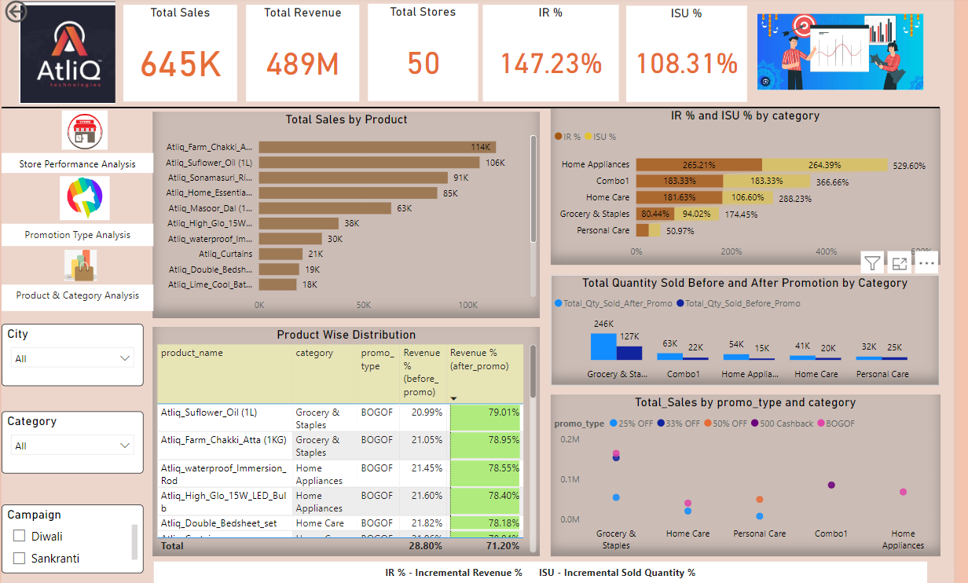
Product and Category Analysis
The product and category analysis gives us detail insights about which product did exceptionally well after the promotions. It also helps us to understand the comparison of before promotion and after promotion figures.
Notes:
The most sold product was under grocery and staples category. We can also see the difference in Revenue % of the products after the promotions.

Slide 15
Insights and Recommendations
Store Performance Analysis
Insight - Three major cities that collectively generated major revenue post promotions are Bengaluru, Chennai and Hyderabad. These cities also hold maximum number of stores in the southern part of India.
Recommendation
Given that the above 3 cities have performed substantially well , there should be more focus on customer engagement, good customer service and support, customer retention strategies to further boost sales and revenue.
Continue investing in promotional offers during festive season for other high value products to stimulate sales and attract new customers.
Ensure there is sufficient stock availability to meet the customer demands during festival promotional campaign.

Slide 16
Insights and Recommendation
Promotion type analysis
Insight
Buy One Get One Free (BOGOF) promotion exhibit fantastic performance boasting highest sales and revenue generation numbers when compared other promotion type like 500 Cashback and other discount offers.
Other discount promotions such as 25% OFF, 33% OFF and 50 % OFF could not attract the customers resulting into low IR % and ISU % .
Diwali promotion campaign was more successful than Sankranti.
Recommendation
More promotion offers should be included like 200 cashback , Buy 2 Get 1 free for grocery items per the festive season to boost the sales and revenue.
Planning and effective marketing strategy required for uplifting the sales and revenue numbers for other discount offers.

Slide 17
Insights and Recommendation
Product and Category Analysis
Insights
Among the categories, Grocery & Staples and Combo were the top selling categories during the promotions.
Home Appliances and Combo 1 categories experienced the highest ISU.
Due to BOGOF promotional offer, Grocery items such as AtliQ Sunflower Oil and AltiQ Farm Chakki Atta were among the most purchased item followed by AtliQ waterproof Immersion Rod, AtliQ High Glow 15W LED Bulb, Atliq Double Bedsheet which generated substantially high revenue.
Hence, we can also say that the good promotional deal can lead to higher sales.
Recommendation
Allocate resources and marketing strategies towards categories with higher ISU% to capitalize on seasonal demand so that we can leverage the opportunity for making maximum revenue.

Slide 18


